Slide 1
Underwater Optical Sensor Network
Max Ruiz
Professor Cody Youngbull
NASA Space Grant

Slide 2
Abstract
Large potential for high speed underwater communication using optical networks
Sensor technology is expanding in oceanography, geology, and defense systems
“Sensorbot” nodes are being designed to operate in multi-hop networks
Each node records a set of data and uses optical transmission to communicate.

Slide 3
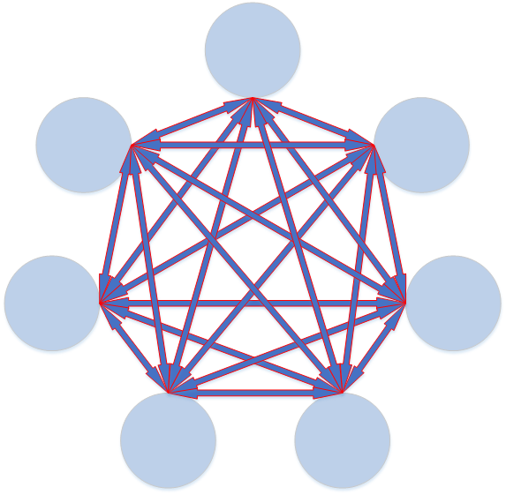
System Requirements
Multi-hop network
Much like Cellphones today
Communication through optics
Analog filter design
Necessary for receiving data
Digital filter design
Microprocessors and FPGA

Slide 4
Approach
Communication
Set baud rate (115.2k)
Employ communication protocol: IrDA
Filtering
Analog filter with large Signal to Noise Ratio
Digital filtering applies statistical filtering
Exhibit bit correction for very small bit error

Slide 5
Future work
Solid communication platform established
Implement sensors
Devise sustainable power systems to increase life

